Slide 1
Multiple Regression
Dr. Frank Wood

Slide 2

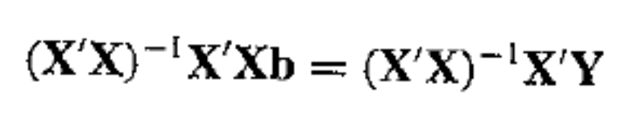

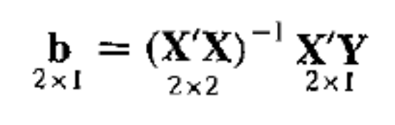
Review: Matrix Regression Estimation
We can solve this equation
(if the inverse of X’X exists) by the following
and since
we have

Slide 3
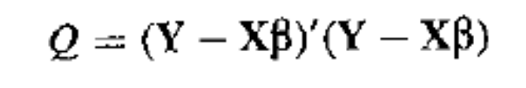
Least Squares Solution
The matrix normal equations can be derived directly from the minimization of
w.r.t. to ¯
Do this on board.

Slide 4
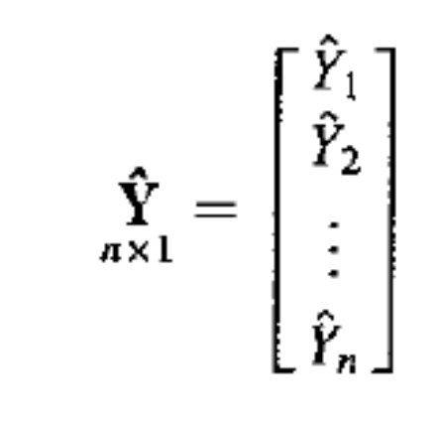
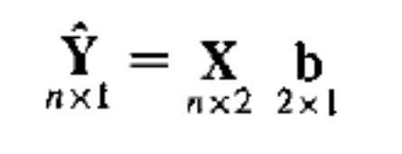
Fitted Values and Residuals
Let the vector of the fitted values be
in matrix notation we then have

Slide 5

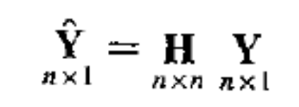
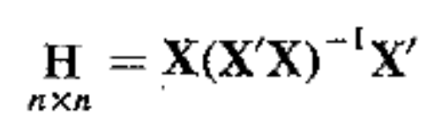
Hat Matrix – Puts hat on Y
We can also directly express the fitted values in terms of only the X and Y matrices
and we can further define H, the “hat matrix”
The hat matrix plans an important role in diagnostics for regression analysis.
write H on board

Slide 6

Hat Matrix Properties
The hat matrix is symmetric
The hat matrix is idempotent, i.e.
demonstrate on board

Slide 7
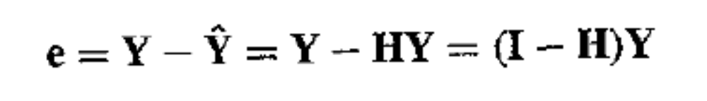
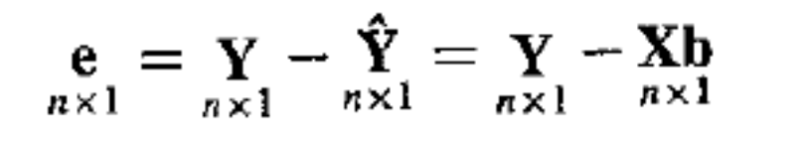
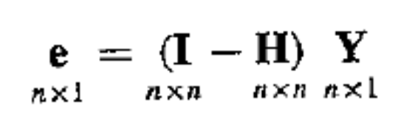
Residuals
The residuals, like the fitted values of \hat{Y_i} can be expressed as linear combinations of the response variable observations Y_{i}

Slide 8





Covariance of Residuals
Starting with
we see that
but
which means that
and since I-H is idempotent (check) we have
we can plug in MSE for ¾² as an estimate

Slide 9
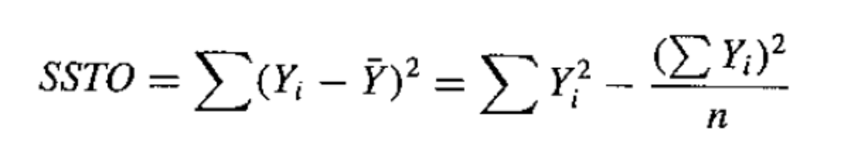
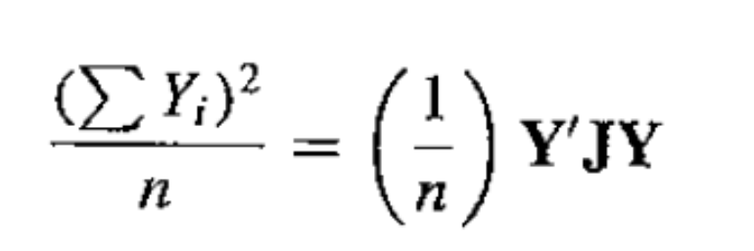

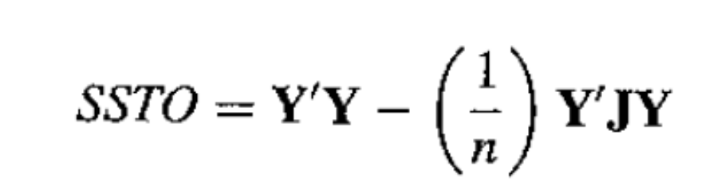
ANOVA
We can express the ANOVA results in matrix form as well, starting with
where
leaving
J is matrix of all ones, do 3x3 example

Slide 10
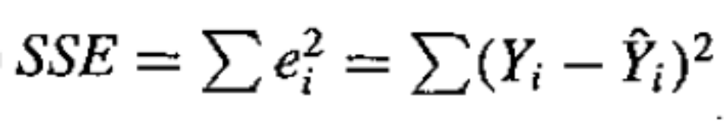
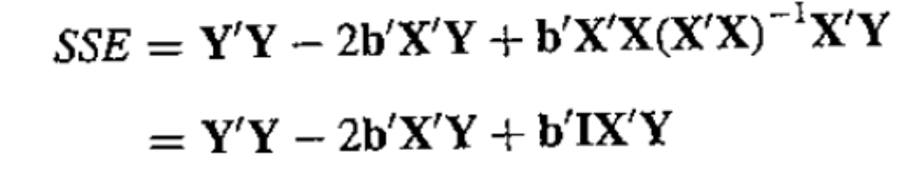
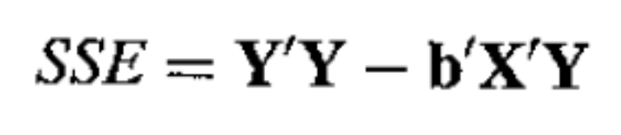
SSE
Remember
We have
Simplified
derive this on board
and this
b

Slide 11
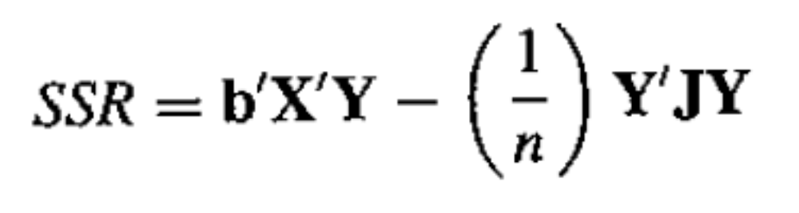
SSR
It can be shown that
  for instance, remember SSR = SSTO-SSE
write these on board

Slide 12
Tests and Inference
The ANOVA tests and inferences we can perform are the same as before
Only the algebraic method of getting the quantities changes
Matrix notation is a writing short-cut, not a computational shortcut

Slide 13
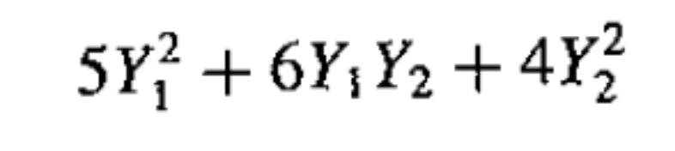
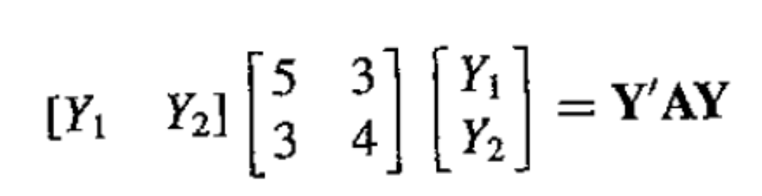
Quadratic Forms
The ANOVA sums of squares can be shown to be quadratic forms. An example of a quadratic form is given by
Note that this can be expressed in matrix notation as (where A is a symmetric matrix)
do on board

Slide 14
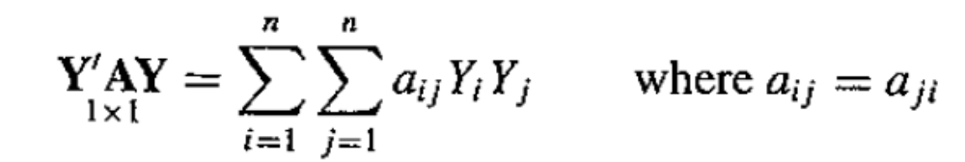
Quadratic Forms
In general, a quadratic form is defined by
A is the matrix of the quadratic form.
The ANOVA sums SSTO, SSE, and SSR are all quadratic forms.

Slide 15
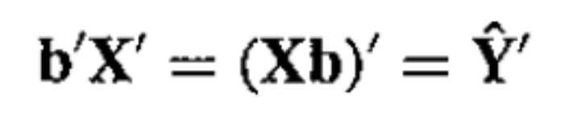
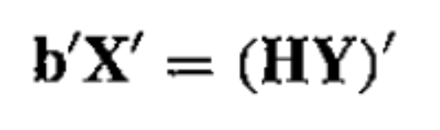
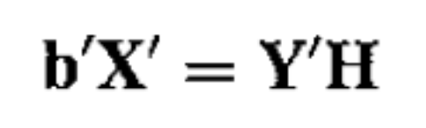
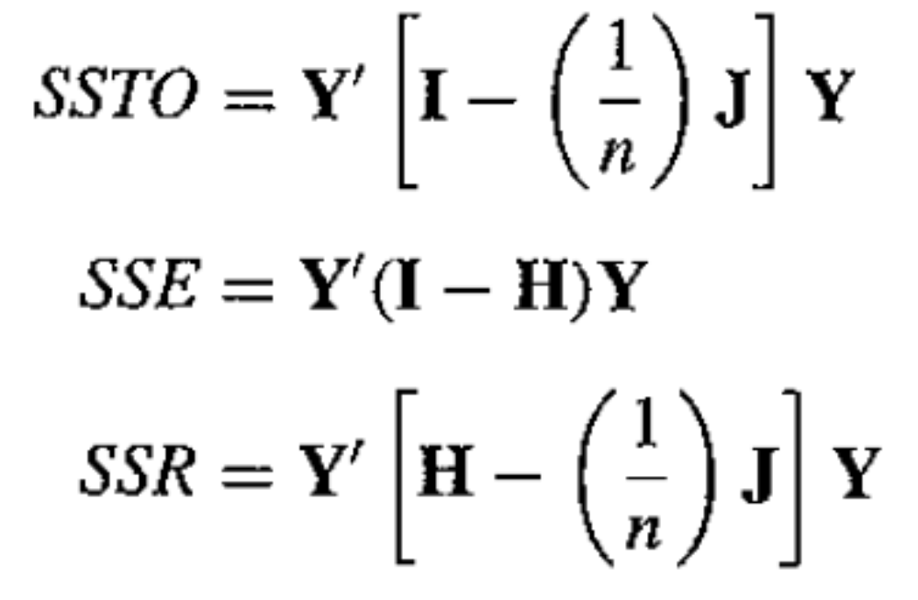
ANOVA quadratic forms
Consider the following re-expression of b’X’
With this it is easy to see that

Slide 16
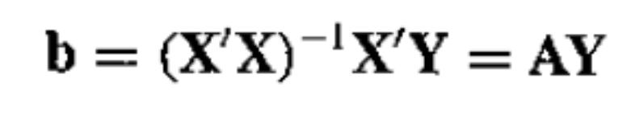



Inference
We can derive the sampling variance of the ¯ vector estimator by remembering that
where A is a constant matrix
which yields

Slide 17
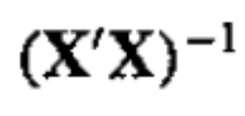
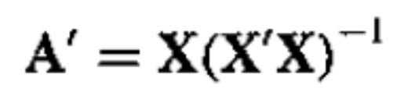
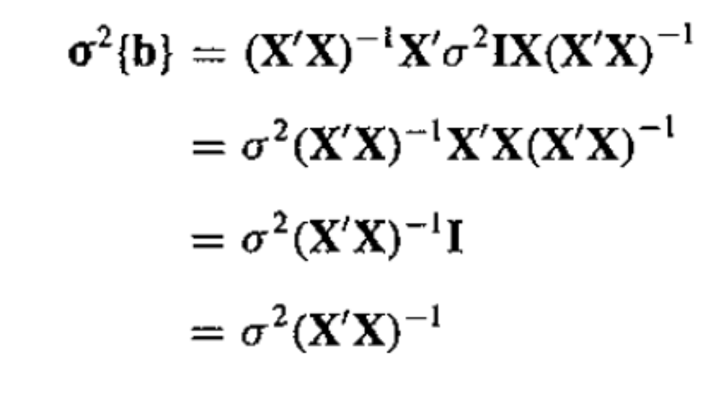
Variance of b
Since is symmetric we can write
and thus

Slide 18
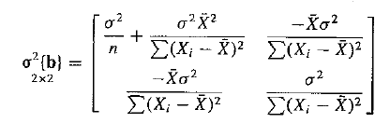
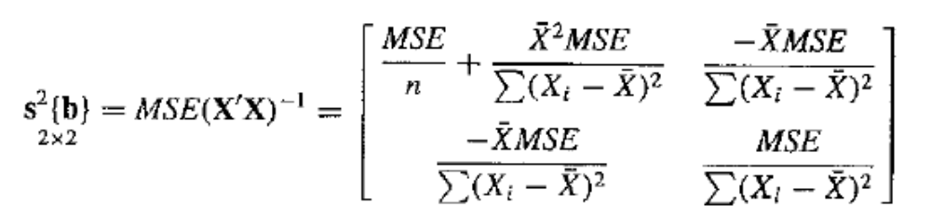
Variance of b
Of course this assumes that we know ¾². If we don’t, we, as usual, replace it with the MSE.

Slide 19
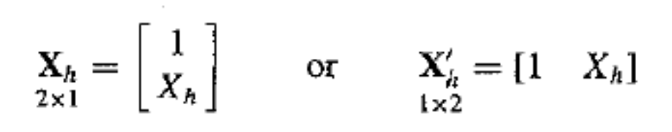
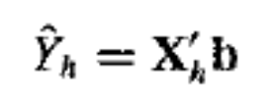
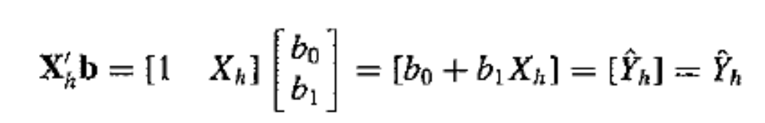
Mean Response
To estimate the mean response we can create the following matrix
The fit (or prediction) is then
since

Slide 20
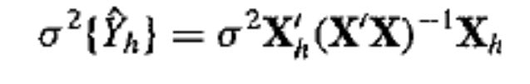
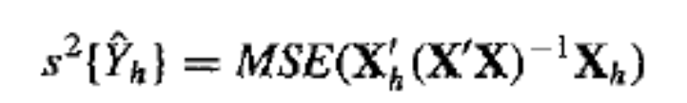
Variance of Mean Response
Is given by
and is arrived at in the same way as for the variance of ¯
Similarly the estimated variance in matrix notation is given by

Slide 21
Wrap-Up
Expectation and variance of random vector and matrices
Simple linear regression in matrix form
Next: multiple regression

Slide 22
Multiple Regression
One of the most widely used tools in statistical analysis
Matrix expressions for multiple regression are the same as for simple linear regression

Slide 23
Need for Several Predictor Variables
Often the response is best understood as being a function of multiple input quantities
  Examples
    Spam filtering – regress the probability of an email being a spam message against thousands of input variables
    Football prediction – regress the probability of a goal in some short time span against the current state of the game

Slide 24
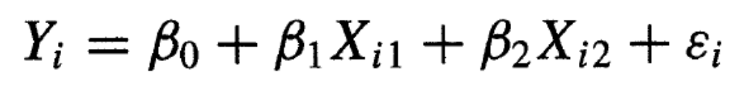
First-Order Model with Two Predictor Variables
When there are two predictor variables X₁ and X₂ the regression model
is called a first-order model with two predictor variables.
A first order model is linear in the predictor variables.
X_{i1} and X_{i2} are the values of the two predictor variables in the ith trial

Slide 25
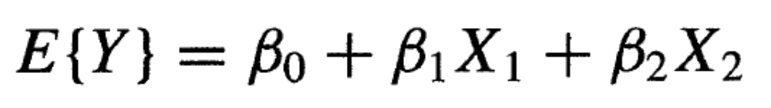

Functional Form
Assuming noise equal to zero in expectation
The form of this regression function is of a plane
  e.g.

Slide 26
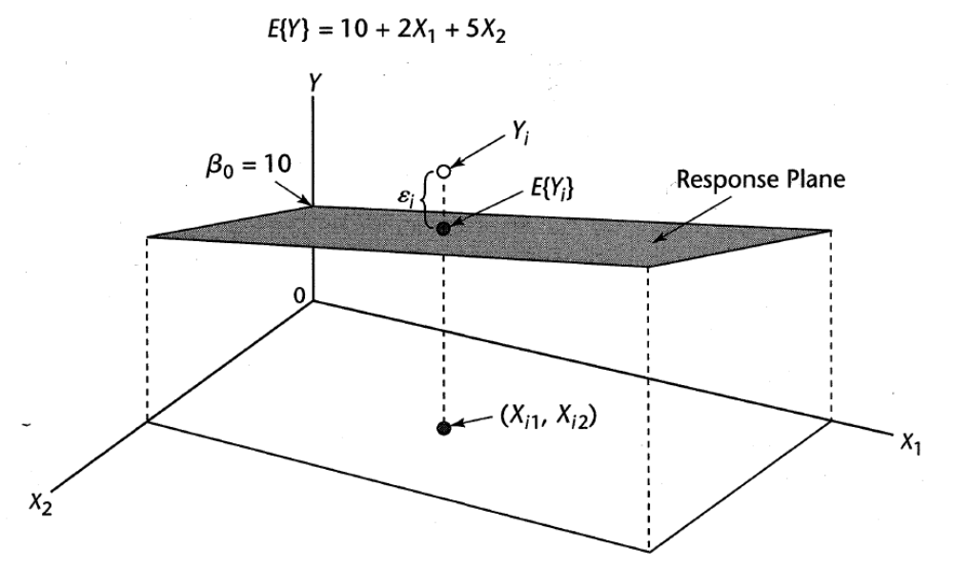
Regression (response) surface

Slide 27
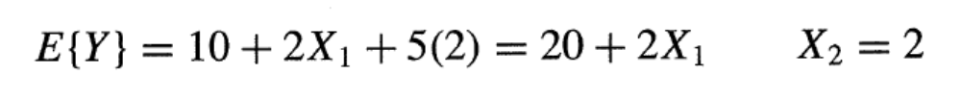
Meaning of Regression Coefficients
¯₀ is the intercept when both X₁ and X₂ are zero
¯₁ indicates the change in the mean response E{Y} per unit increase in X₁ when X₂ is held constant
¯₂ – vice versa
Example – fix X₂ = 2
intercept changes but interpretation is clear

Slide 28
Terminology
When the effect of X₁ on the mean response does not depend on the level of X₂ (and vice versa) the two predictor variables are said to have additive effects or not to interact.
The parameters ¯₁ and ¯₂ are sometimes called partial regression coefficients

Slide 29
Comments
A planar response surface may not always be appropriate, but even when not it is often a good approximate descriptor of the regression function in “local” regions of the input space
The meaning of the parameters can be determined by taking partials of the regression function w.r.t. to each.

Slide 30
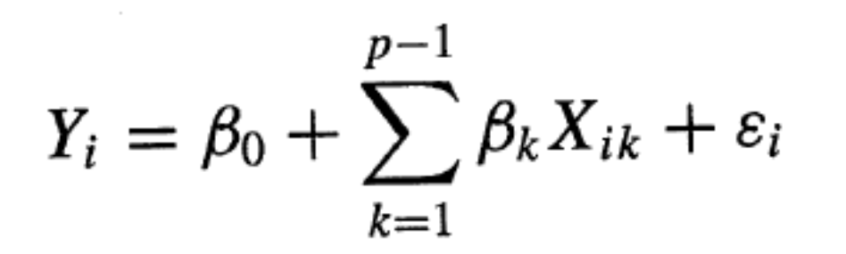
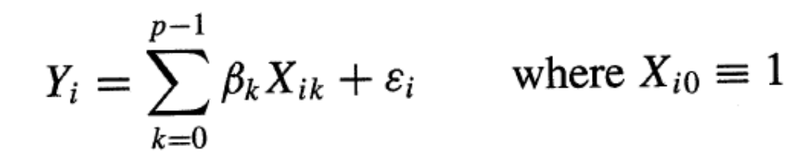
First order Model with >2 Predictor Variables
Let there be p-1 predictor variables, then
which can also be written as
and if X_{i0} = 1 is also can be written as

Slide 31
Geometry of response surface
In this setting the response surface is a hyperplane
This is difficult to visualize but the same intuitions hold
  Fixing all input variables, each ¯ tells how much the response variable will grow or decrease according to its own (and only its own) input variable

Slide 32
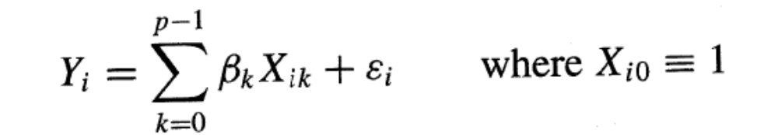
General Linear Regression Model
We have arrived at the general regression model. In general the X₁, …, X_{p-1} variables in the regression model do not have to represent different predictor variables, nor do they have to all be quantitative (continuous).
The general model is
with response function (when E{²_{i}} =0)

Slide 33
Qualitative (Discrete) Predictor Variables
Until now we have (implicitly) focused on quantitative (continuous) predictor variables.
Qualitative (discrete) predictor variables often arise in the real world
  Examples
    Patient sex: male/female/other
    Goal scored in last minute: yes/no
    Etc.

Slide 34
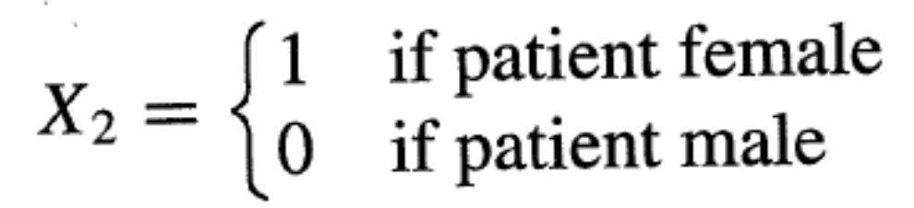
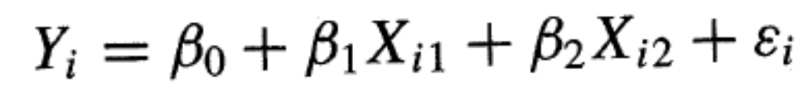
Example
Regression model to predict the length of hospital stay (Y) based on the age (X₁) and gender (X₂) of the patient. Define X₂ as
And use the standard first-order regression model

Slide 35
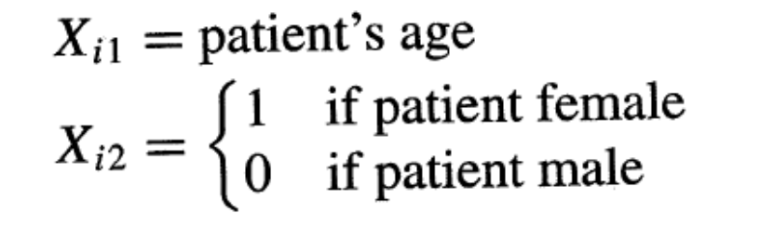
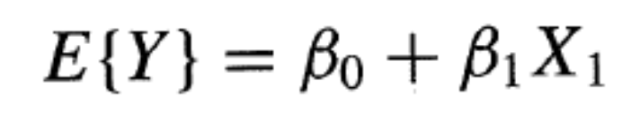
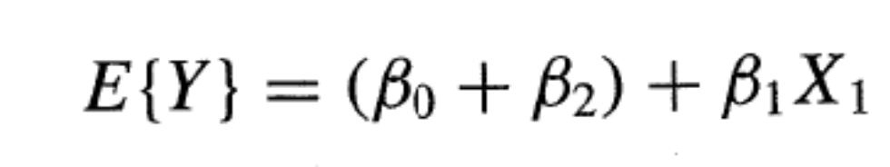
Example cont.
Where
If X₂ = 0 (i.e. patient is male) the response function is
otherwise it is
which is just another (parallel) linear response function with a different intercept

Slide 36
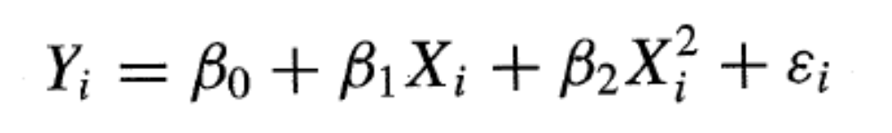
Polynomial Regression
Polynomial regression models are special cases of the general regression model.
They can contain squared and higher-order terms of the predictor variables.
The response function becomes curvilinear.
For example
which clearly has the same form as the general regression model.

Slide 37
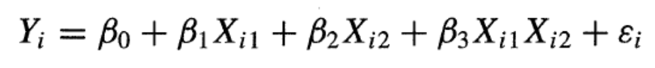
General Regression
Transformed variables
  log Y, 1/Y
Interaction effects
Combinations
Key point – all linear in parameters!

Slide 38
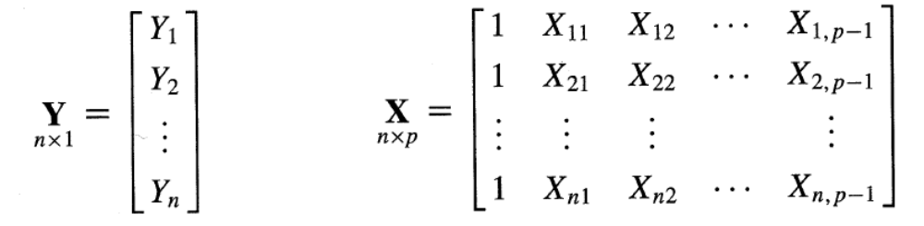

General Regression Model in Matrix Terms

Slide 39





General Linear Regression in Matrix Terms
With
and
We have and

Slide 40

Least Squares Estimation
Same as before
Maximum likelihood under iid normal error assumption results in same estimator
Fitted values and residuals the same as before as well.
WRONG!!!!

Slide 41

ANOVA
The sums of squares derived before are the same here
but now we have to account for more parameters

